Slide 1
Classification project on cardiovascular Risk prediction. - Under the guidance of alma better made by - Ankit Gupta

Slide 2
Index
Introduction
Literature survey
Problem formulation
Methodology and algorithms
Experimental results
Conclusion

Slide 3
Problem statement
Given the clinical parameters about the patients , we have to predict whether they have heart disease or not.

Slide 4
Literature Survey
This presentation investigates the state of the art of various clinical decision support systems for heart disease prediction , proposed by various researchers using machine learning techniques.

Slide 5
Approach Methodolgy
Machine learning algorithms:
Binary classification
Naïve bayes(NB)
Random Forest(RF)
Adaptive boosting(Adaboost)

Slide 6
RANDOM FOREST ALGORITHM
The missing values will be handled by the random forest classifier , which will maintain the detection rate of a large portion of the data.
The random forest is made in two stages :
The first is to join N choices to make the arbitrary timberland and second is to make any expectation for each tree created in principal stage.

Slide 7
BAYES THEOREM
It states that when determining a conditional probability , the final output is determined by each conditional probability.
Naïve bayes classifier have exceptionally good performance on the grounds that they require a bunch of boundaries that is relative to the quantity of characteristics in a learning issues.

Slide 8
Adapting boosting algorithms
It is a technique in machine learning used as an ensemble method
The most common algorithm used with adaptive boosting is decision tree with one level that means with decision tree with only one split.
The weights are reassigned to each instance , with higher weights assigned to incorrect classified instances.

Slide 9
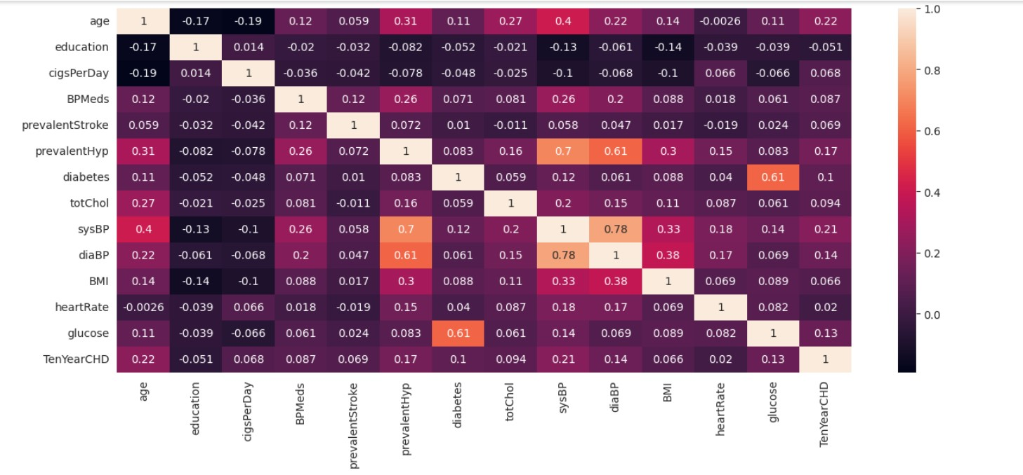
Initial results
By far we have checked the correlation between features and correlation of the target variable.

Slide 10
Conclusion
The prediction exhibition of each technique and apply the proposed system for the area it required . The accuracy achieved for naïve bayes is 85.25 % and Random forest showed 90.16 % and adaptive boost displayed 90.16 %.
We desired to apply AI to exhibit a connection between cardiovascular illness and air quality.

Slide 11
THANK YOU

